Slide 1
Forging a National Republic, 1776-1789
We the People . . .

Slide 2
Was the Revolution Radical?
The Fundamental Roots of Inequality Prior to the Revolution Were Racial, Gendered, and Class. Did the Revolution alter this? If Not, How Can it Be Radical?

Slide 3
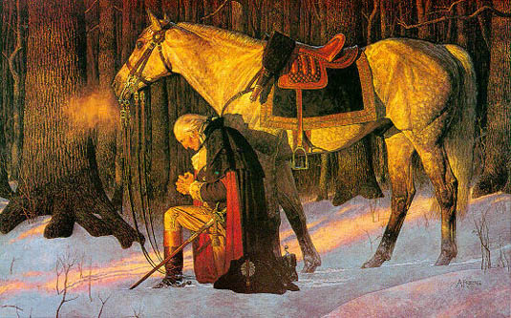
Is America a Christian Nation?

Slide 4
Key Terms
Articles of Confederation
Shays Rebellion
Republicanism
Civic Virtue
Northwest Ordinance
Virginia Plan
New Jersey Plan
James Madison
Federalists
Anti-Federalists
Bill of Rights
Ratification

Slide 5
Outline
I. Group Work
A. Causes of the American Revolution
B. During the War
II. Articles of Confederation
III. Battle of York Town
IV. Treaty of Paris
V. Shays’s Rebellion
VI. Constitutional Convention

Slide 6
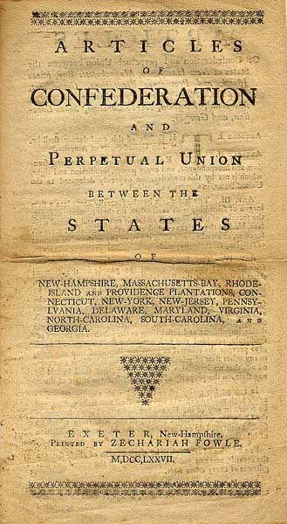
Articles of Confederation, Drafted 1776, Ratified 1781.

Slide 7
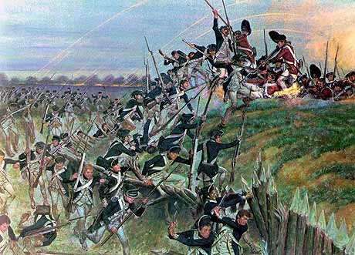
Battle of Yorktown, 1781

Slide 8
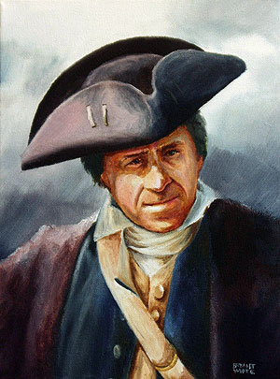
Shays’s Rebellion

Slide 9
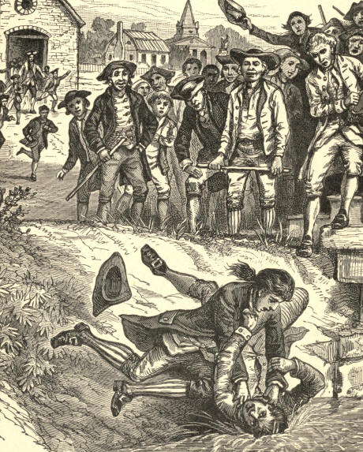

Slide 10
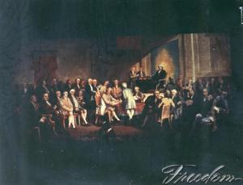
Constitutional Convention

Slide 11
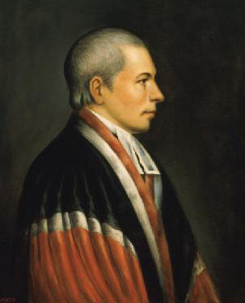
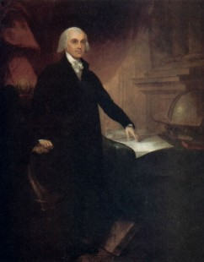
Virginia Plan vs. New Jersey Plan
James Madison, VA Plan
William Patterson, NJ

