Slide 1
The Quest for Empire
Is it Acceptable for the United States to Have an Empire?

Slide 2
I. White Man’s Burden
II. Missions, Markets, and Military
III. Cuba, Spanish American War
IV. Philippine Insurrection
V. Mexican Revolution
VI. Debate

Slide 3
Answer these Questions:
Who is your group? Gender, Race, Age, Class, Region, Time Period?
What change do they want to achieve? What reforms do you want to make?
How will you make/achieve these changes?
How will the changes you make benefit society?

Slide 4
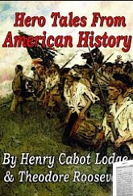
Teddy Roosevelt: To Be An American
Hero Tales

Slide 5
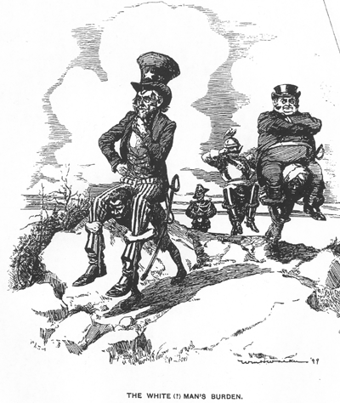
The White Man’s Burden: Rudyard Kippling

Slide 6
Significance: Ideas of American Exceptionalism and the White Man’s Burden Coupled with the Closing of the Frontier Ushered in a Shift in American Isolationism and Foreign Policy.
Empire Resulted.

Slide 7
The Spanish American War
Fighting for Freedom or Manipulating Empire?

Slide 8
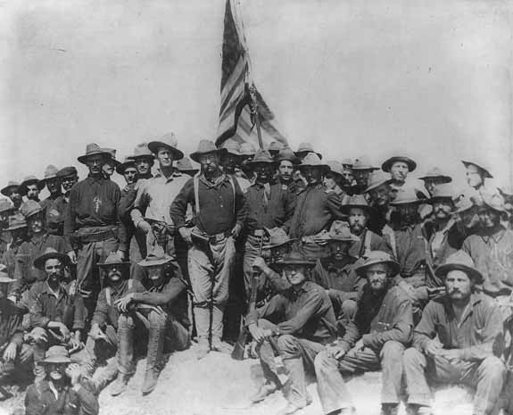
Spanish American War: San Juan Hill
Then Lieutenant Colonel, US Army Teddy Roosevelt and his Rough Riders at the top of the hill, Battle of San Juan, during the Spanish-American War.

Slide 9
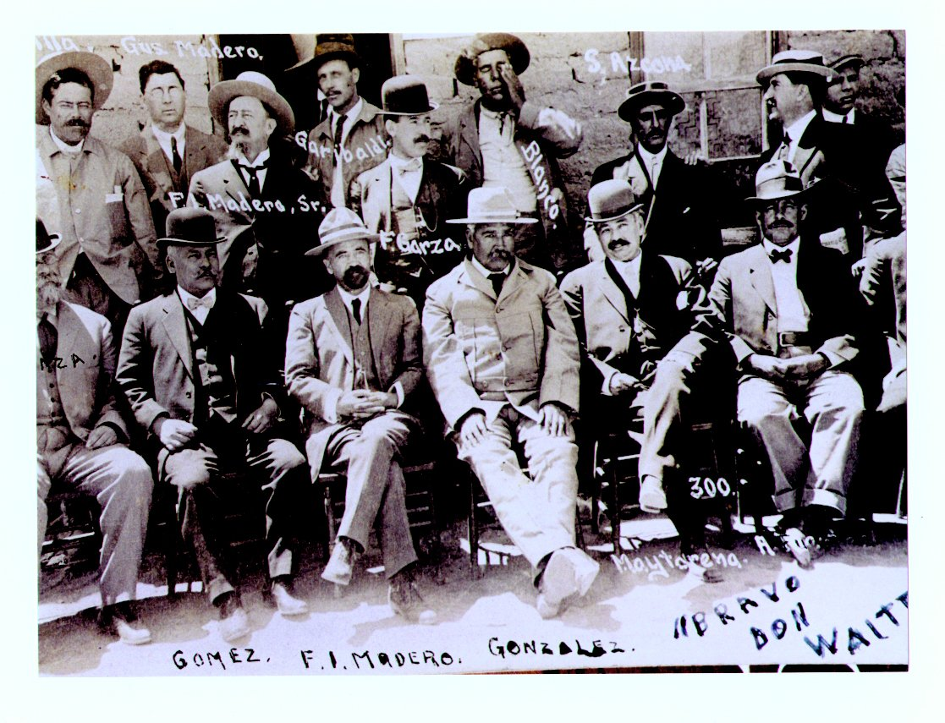
Mexican Revolution

Slide 10
Empire: The American or Anti-American Way?

