Slide 1
How did resistance to British taxation become a social revolution?

Slide 2
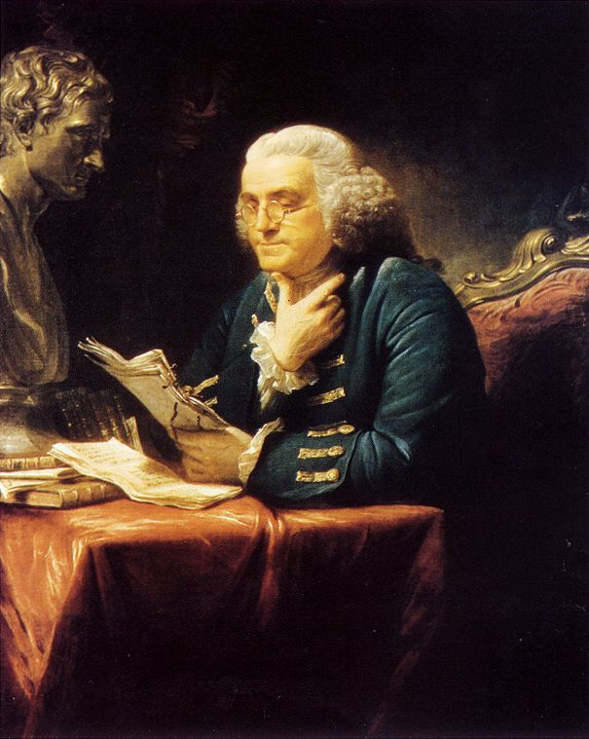
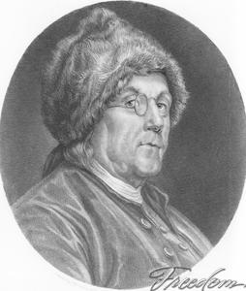
From Genteel Briton to Rustic American
Before 1774
After 1774

Slide 3
Outline
I. Reluctant Revolutionaries
II. Significance of Stamp Act Revisited
III. American Reaction to the Intolerable Acts

Slide 4
Terms
George Washington
First and Second Continental Congress
Loyalists
Patriots
Common Sense
Continental Army

