Slide 1
Cutting the Bonds of Union:
The South Secedes

Slide 2
Key Question
Who is most to blame for the violence leading up to the war?

Slide 3
Significance
Lincoln’s election to the presidency in 1860 without wining a single Southern state epitomized the loss of Southern political power.
The North had enough power to pass any laws they desire without having to make further concessions to the Slaveocracy.

Slide 4
Outline
I. Crisis Intensifies
A. Kansas-Nebraska Act 1854
B. Ascension of the Republican Party
C. Bleeding Kansas, 1855
D. Canning of Charles Sumner 1855
E. Dredd Scot Decision 1857
F. John Brown’s Raid, 1859
II. South Secedes
A. Election of Lincoln 1860
B. Fort Sumter April 1861

Slide 5
Key Terms
Kansas Nebraska Act
Republican Party
Abraham Lincoln
John Brown
Charles Sumner
Preston Brooks
Fort Sumter
Election of 1860
Dredd Scott

Slide 6
Map of Slave and Free States

Slide 7
Kansas Nebraska Territory

Slide 8
Kansas Nebraska Act
American painter John Steuart Curry's mural, Tragic Prelude, depicts abolitionist John Brown during the "Bleeding Kansas" decade of the 1850s

Slide 9
Bleeding Kansas

Slide 10
Caning of Charles Sumner

Slide 12
Dredd Scott

Slide 13
John Brown

Slide 14
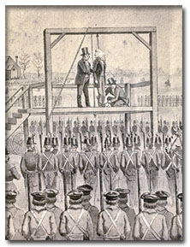
Raid on Harper’s Ferry, 1859

Slide 15
Lincoln, Elected 1860

Slide 16
Election of 1860 Chart

Slide 18
Attack on Fort Sumter

Slide 19
Leaving Question: What is your reaction to these two maps?
Slave vs. Free States
Republican vs. Demo Map: Modern

